Slide 1
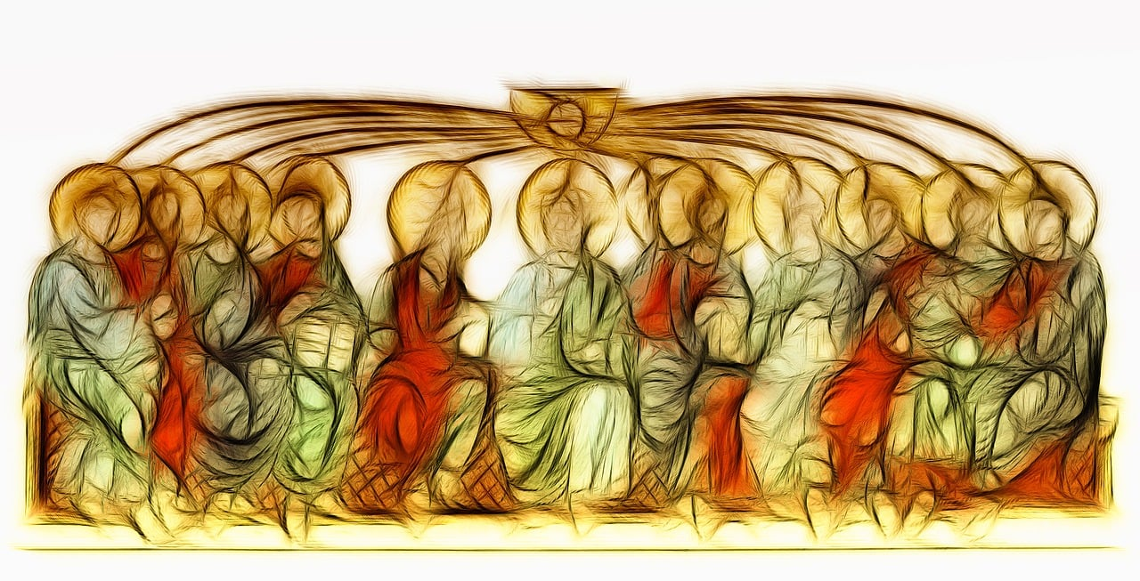
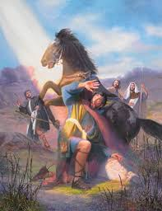
Big Questions
How can energy transform?
How can I transform my energy for the good of others?
Year 5 Topic 7: Transformation
Pentecost: Celebration of the Holy Spirit’s transforming power
Learn and Grow Together in Christ
Key Scripture
Acts 1:8
But you will receive power when the Holy Spirit has come upon you; and you will be my witnesses in Jerusalem, in all Judea and Samaria and to the ends of the earth.
What I should know already
The new life of the Easter message is spread through the power of the Holy Spirit
Key Vocabulary
Transformation | A major change in the shape, character or nature of someone or something.
Transform | To change the form, look or shape of something.
Energy | The power to make something work or be active.
Holy Spirit | The Holy Spirit is God, as is the father, and as is the Son. Nobody has seen the Holy Spirit, but we can see the works of the Holy Spirit through the joy, courage and strength that he gives.
Gifts of the Holy Spirit | The gifts of the Holy Spirit help people to lead good lives and make use of the gifts they have; wisdom, understanding, counsel, fortitude, knowledge, piety, awe and wonder.
Fruits of the Holy Spirit | The fruits of the Holy Spirit are; love, joy, peace, patience, kindness, goodness, trustfulness, gentleness and self control.
Other vocabulary | Wind, fire, change, transform
Sticky Knowledge
The Road to
Emmaus
Peter
The Gifts of the Holy Spirit are for everyone
The transformation of Paul
How Paul spread
the Good News
How the power of the Holy Spirit helps Christians today
The fruits of the
Holy Spirit

